Slide 1

Project #1
Exploring the Relationship
Between 2 Datasets:
Airbnb & Starbucks

Slide 2
MC Squared – Class Project #1
The MC Square Team
Project Overview
Data Selection, Collection & Cleanup
Approach & Findings
Lessons Learned

Slide 3

Matt Dipinto
Git Master
Data Cleanser
Plot Master
When Matt’s not sharing links to the class on slack, you can find him sneaking Belle into Christmas Parties.

Slide 4

Christine Kanouff
Content Creator
Visual Effects
Editor
When Christine’s not prompting ChatGPT for homework help, she’s planning her next bucket list trip.

Slide 5

Cindy Zhou
Developer
Mapping Queen
Data Specialist
When Cindy’s not fast tracking through class assignments, she’s spending time with friends at Cirque Soleil.

Slide 6

Project Overview
We wanted to explore an interesting dataset.
This ruled out sports and financial datasets.
Things we had in common? Travel & Coffee
The Airbnb data looked interesting, and we had a belief that Starbucks probably had the most reliable way to predict store location success.

Slide 7
Project Overview
The Questions We Hoped to Answer:
What Does the Airbnb Market Look Like?
How has it grown and what can we forecast?
How Do Locations Correlate?
Is there a relationship between Starbucks and Airbnb locations?
How do Starbucks locations impact quality or cost of an Airbnb?
What does it look like if we compare 2 diverse markets?
Can We Predict a Good Location?
Two Very Important Keys To Our Approach:
Assign the Right Person to the Right Task.
Keep it Simple and Test the Denver Market First.

Slide 8

Project Overview
But, we also asked our team: Is this a real-life example?
Yes, Here’s Our Client:
Semi-retired actor who wants to add a reliable income stream to his already-healthy portfolio of investments.
Is an Airbnb a good long-term investment for Anthony? And if so, in what market?

Slide 9


Data Selection, Collection & Cleanup
Both Starbucks and Airbnb had datasets that were easy to access. However, financial data was not readily available.
Eliminated Columns (75) Down to 30 Total
Filled NA Data & Replace Null With -1
Cleaned Price Column and Standardized as Float
Converted Bathroom to Number
Removed Outliers (over $2,000)
Converted Dates to Datetime
Pulled in Airbnb Reviews Data
Calculated how often ”Starbucks” was mentioned in review
Selected Columns to Keep
Filter for Location
Postal Code Standardized to Five Digits
Found Average Latitude and Longitude
Calculated within 25 Mile Radius of all Starbucks Locations

Slide 10
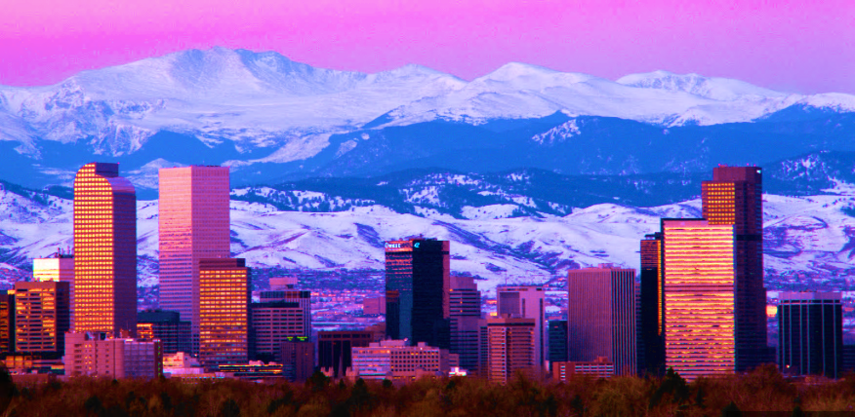

Data Selection, Collection & Cleanup
Final London Datasets:
256 Starbucks
88,701 Airbnb
Final Denver Datasets:
303 Starbucks (Yes, 303)
5367 Airbnb

Slide 11
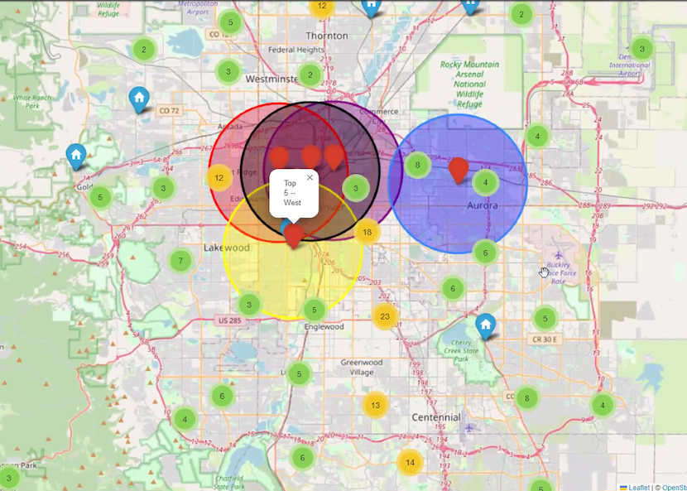
Approach & Findings
Very Import First Look – Denver Data Mapping
Interactive Map:
Aggregates Data
Top 5 Districts:
Airbnb uses the Top 5 ”Districts” to rate neighborhoods. (Hunger Games here we come.)
This Gave us A Sense of What We Could Actually Analyze.
District Map Denver

Slide 12
Approach & Finding
London Data Mapping
Interactive Map: Aggregates Airbnb and Starbucks Data
Findings:
A lot more interesting with more data…
Add London Link

Slide 13
Approach & Findings
What Does the Airbnb Market Look Like?
Insert Times Series Visualizations (Denver & London), View 1

Slide 14
Approach & Findings
Is the Airbnb Market Still Growing?
Insert Times Series Visualizations (Denver & London), View 2

Slide 15
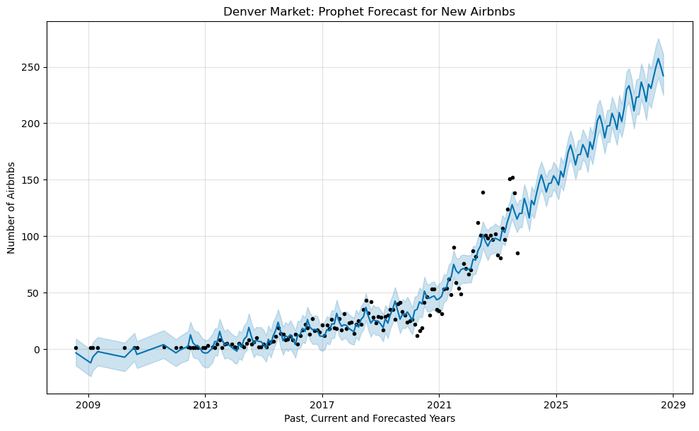
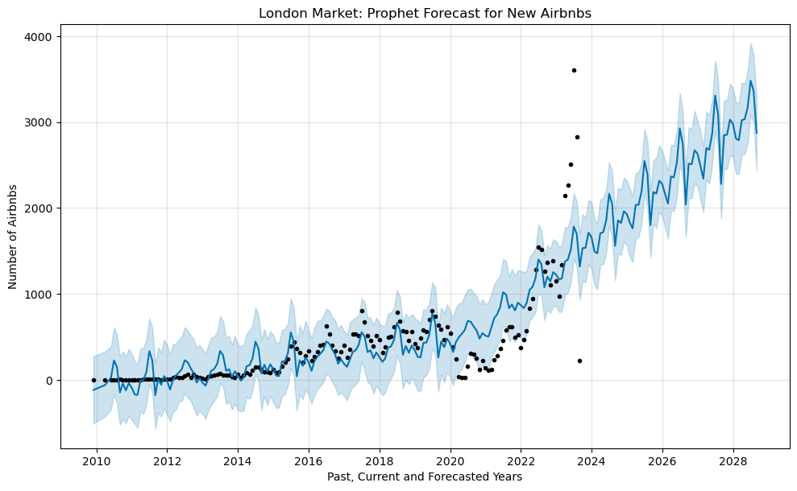
Approach & Findings
What is the Forecast for New Airbnbs?

Slide 16
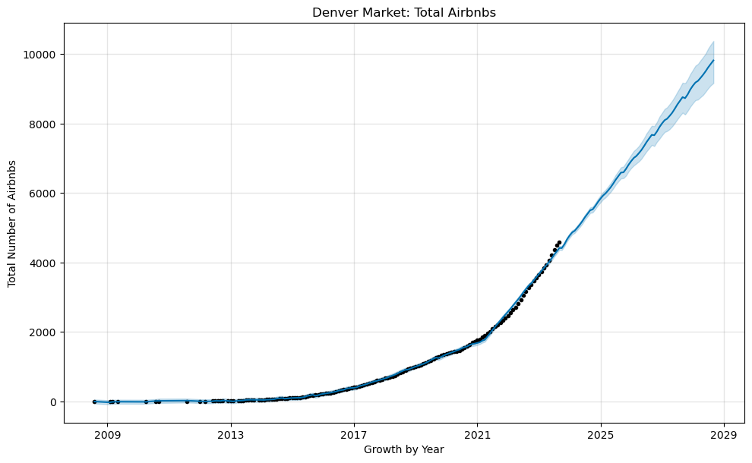
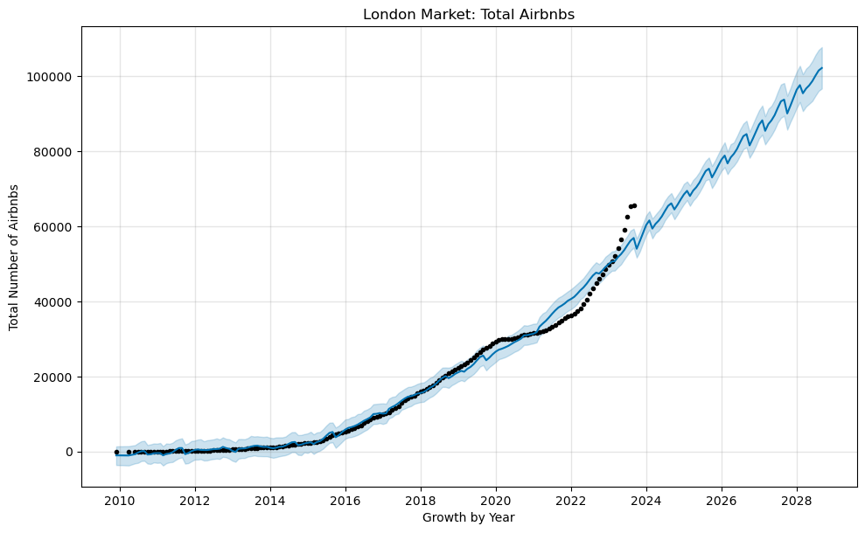
Approach & Findings
What is the Forecast for Total Airbnbs?

Slide 17
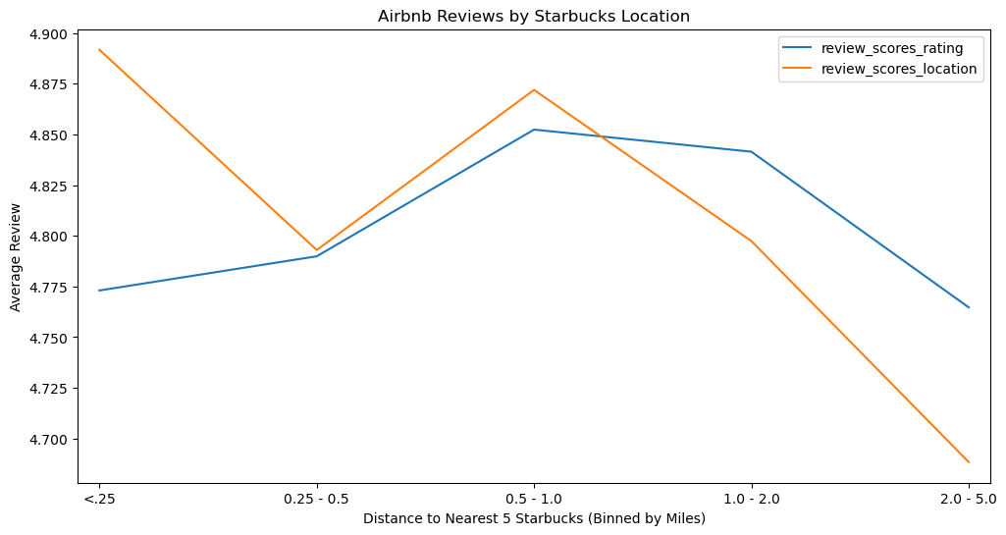
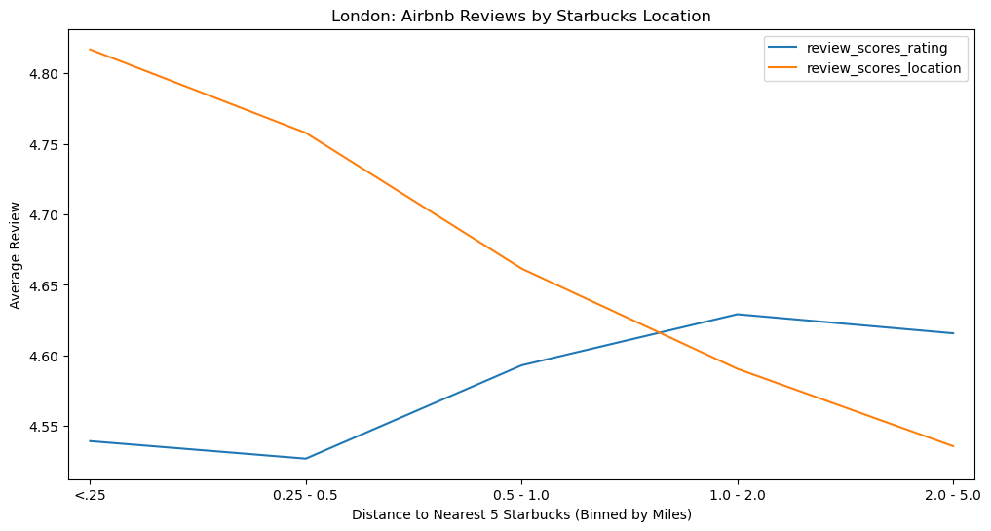
Approach
How Do Top Airbnb Reviews Relate to Starbucks Proximity?
The Denver Market Seems to Suggest that There is a Sweet Spot for Good Reviews

Slide 18
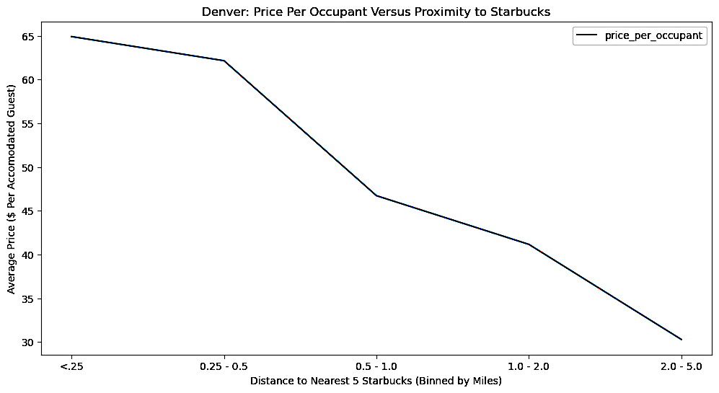
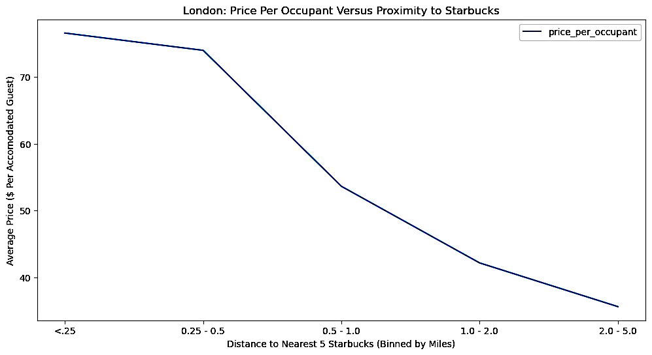
Approach & Findings
Is There A Relationship Between Airbnb Cost & Starbucks Proximity?
Yes, the more expensive the stay, the more Starbucks locations are within walking distance (approximately 5 locations within ½ a mile).

Slide 19
Approach
Question: Are There Any “Obvious” Opportunities
Due to High Density of Starbucks and
Low Density of Airbnb?
We discussed doing a “visual” estimation of this using Matt’s Heat Map. Here would be a good place to link to it.

Slide 20

Lessons Learned
Team Work & Data Analysis:
Keep it small and manageable.
Everything will take longer than you anticipate.
Things will go wrong.
In the end, lean on the in-class experts.

Slide 21
Resources & Articles
https://www.networkworld.com/article/935670/big-data-secrets-from-airbnb-starbucks-and-sonic.html
https://nycdatascience.com/blog/student-works/data-analysis-on-starbucks-location/

Slide 22

Use at your own risk!
THE GRAVEYARD

Slide 23
Title of Slide – Option 1

Slide 24
Title of Slide – Option 2

Slide 25
Helpful Hints Before You Start!
Know Your Dataset & Machine Capabilities:
”Why did the other dataset download so fast?”
”Do you think my MAC will blow up?”
”Feather file, yeah, try that. Or maybe Zip?”
”Okay. Okay. I think this is going to work? Wait. Why is my machine now just spinning?”

Slide 26

Anthony
Our Client:
Semi-retired actor who wants to add a reliable income stream to his already-healthy portfolio of investments.
Taylor

Slide 27
Hired MCSquared to Determine:
Is an Airbnb…a good long-term investment? And if so…in what market?
Anthony Taylor

Slide 28
Some Background on Airbnb
Published by Statista Research Department, Apr 21, 2023
Airbnb has become a global phenomenon since its founding in 2008. As of April 2023, Airbnb's market capitalization valued at 73.34 billion U.S. dollars, up from 54.13 billion U.S. dollars the previous year. Over the past four years, the company's market capitalization peaked in 2021 at over 100 billion U.S. dollars.
Simple Findings = Incredible Impact
Riley Newman, head of analytics and data science at Airbnb, ran a regression to determine the features of a listing that had the most impact on whether it would get booked, and he unearthed a shockingly simple insight: unappealing looking listings don’t get booked. Appealing ones do.
Taking Action
Airbnb eventually rolled out a tool that allowed hosts to request free professional photo shoots, and in the process, not only did they boost bookings, but they earned a ton of loyalty from the owners.

Slide 29

Why Starbucks Data?
Starbucks built a market-planning and store-development application called Atlas. The best way to think of Atlas is as a Big Data analytics tool layered on top of mapping software. Built on Esri’s ArcGIS (GIS stands for Geographic Information System), Atlas lets Starbucks factor in a range of variables that contribute to the success of existing stores, visualize them on maps, and then seek out similar areas for new locations.

Slide 30
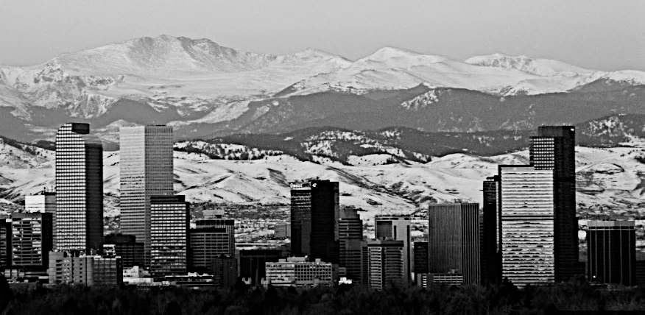
Denver, Colorado
After Cleanup, Final Datasets Included:
303 Denver Starbucks
5,367 Denver Airbnb Sites
In 5 Major Denver Neighborhoods

Slide 31
Data Section, Collection & Cleanup
What Questions Could the Data Help us Answer?
How to Show Results?
Project Overview
?

